Slide 1

CHAT APPLICATION. (PROJECT)

Slide 2
What is chat?
Online chat may refer to any kind of communication over the Internet that offers a real-time transmission of text messages from sender to receiver.
Online chat may address point-to-point communications as well as multicast communications from one sender to many receivers and voice and video chat, or may be a feature of a web conferencing service.

Slide 3
What is chat application?
Online chat in a less stringent definition may be primarily any direct text-based or video-based (webcams), one-on-one chat or one-to-many group chat (formerly also known as synchronous conferencing), using tools such as instant messengers, Internet Relay Chat (IRC), talkers and possibly MUDs.

Slide 4
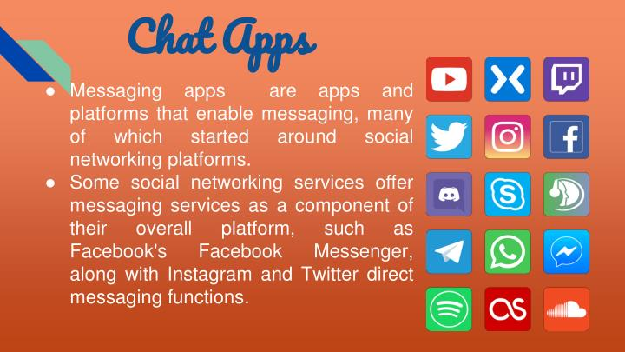

Slide 5
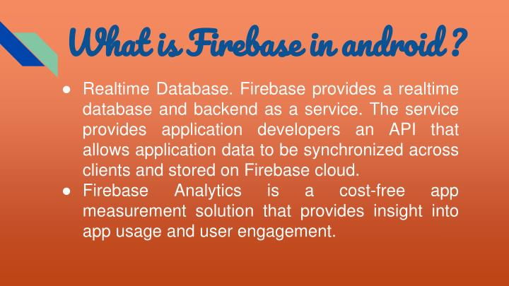

Slide 6
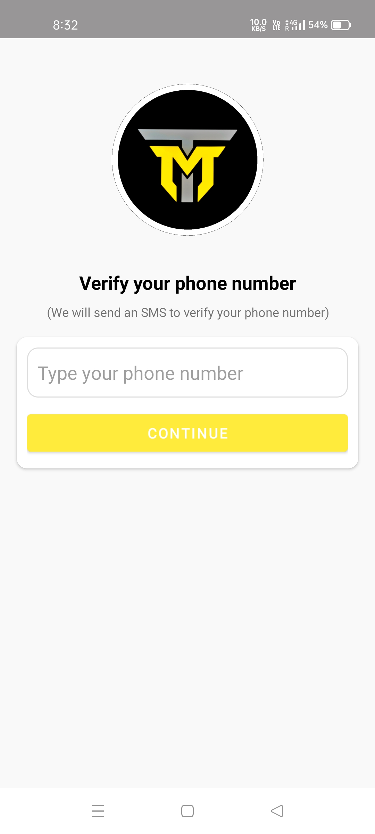
Firebase Chat-Application
-> This is the starting page of our application, which is the home page.
In this the user enters his/her mobile number with the country code, and click on continue button and the app take user to next page.

Slide 7
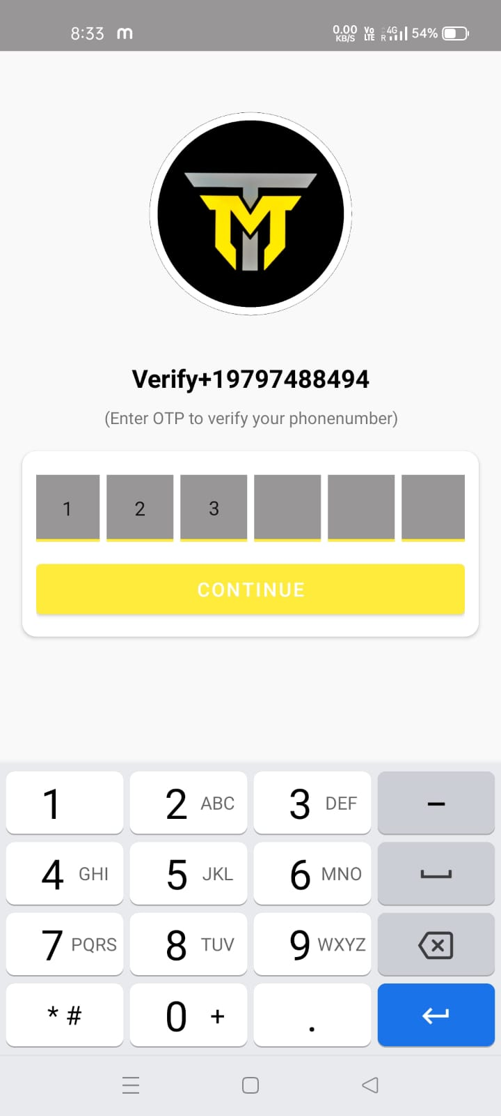
OTP Verification Activity
-> In this user enter the OTP provided by the firebase embedded by us, and click on the continue button which take user to setup profile activity page.

Slide 8
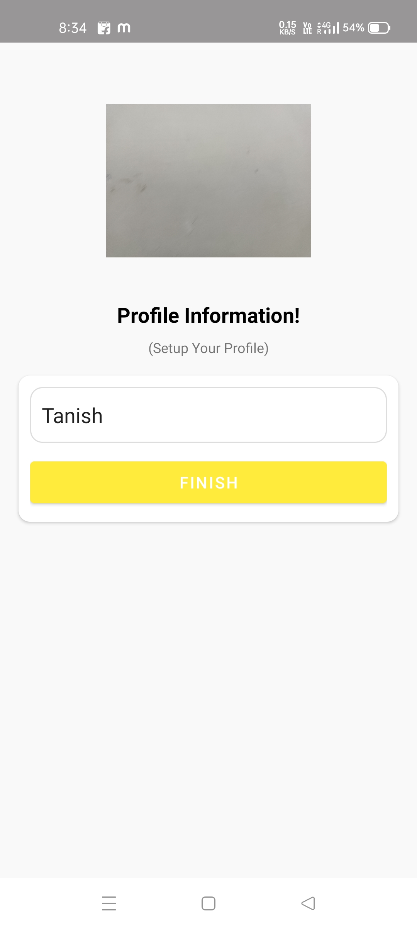
Profile Set-Up Activity
-> After successful OTP submission (verify through firebase automatically),we come to this profile setup activity, in this user select and apply a new profile picture, and set his/her name and confirm its and the data gets save in the firebase.

Slide 9
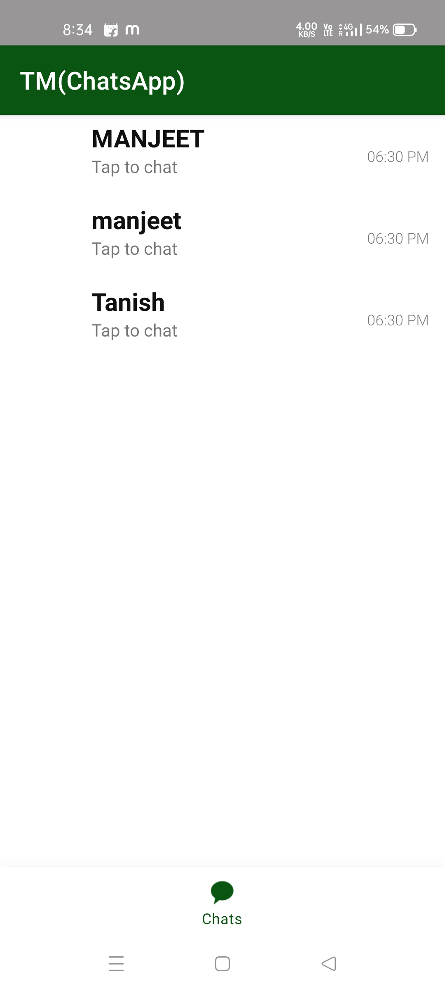
Home Page Activity
-> This is the homepage of the chats app where the user get the name of the active users of this application and can start conversation with other users.

Slide 10
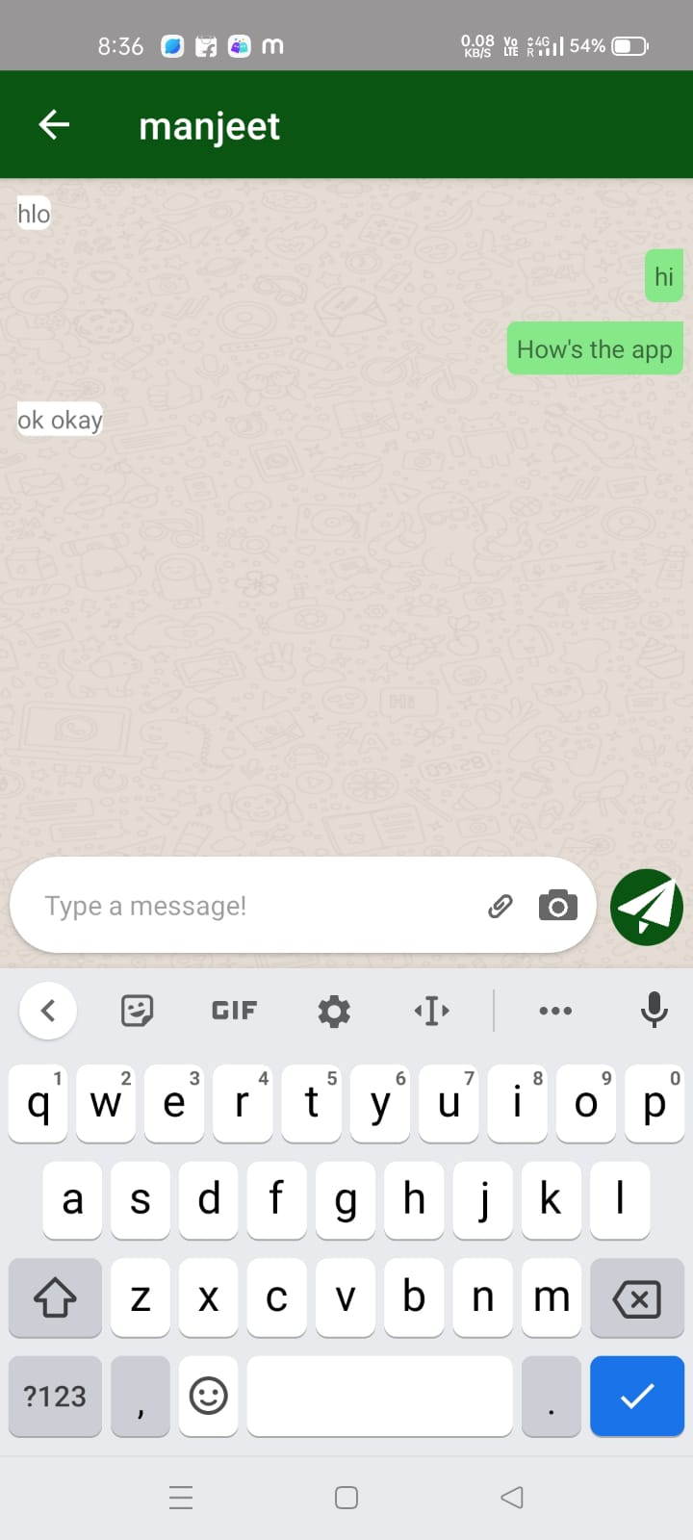
Main Chat-Activity
-> This is the main chat activity, where there is message text bar and a send button, where the user types the message and send it and the opposite user receive the message and can reply to it.

Slide 11
Presented to you by:
*Tanish Gupta (1817454)
*Manjeet Singh(1817442)
*Sandeep Kumar(1817451)
*Deepak Kumar(1817439)
*Robin Singh(1817475)
(Android Chat-Application{Firebase})

